Slide 1
Typed Lambda Calculi An Introduction to Type Systems
Prof. Dr. Farhad Mehta
Department of Computer Science

Slide 2
Goals
Each participant should be able to:
Explain how type checking and type inference is done in the simply typed lambda calculus and the polymorphic lambda calculus.
Perform type checking and simple type inference in these type systems.
Read, understand and explain standard texts in this area.
Explain the concepts subtyping, covariance & contravariance.

Slide 3
Type Systems Motivation
Consider the term "+ ⊤ ⊥"
Q. Can it be evaluated?
A. Yes: + ⊤ ⊥ = λn.λf.λx. f (n f x) = succ (surprised?!)
Q. Does it make sense?
A. That depends on who is being asked.
There are advantages to avoiding such "ill-typed" terms:
Preventing logical programming and runtime errors
Can be used for runtime performance improvements
Types provide helpful formal documentation
For users: Result in better readability and understanding
For IDEs: Allows support for code completion, refactoring, ...

Slide 4
The Simply Typed Lambda Calculus (λ→)
Excerpts (with slight modifications) from "Introduction to Type Theory" by Erik Barendsen
var
app_{term}
abs_{term}
Note: The base (aka. typing environment) should be seen as a function (from variables to types) that is updated (i.e. overwritten), and not a set that can be added to.

Slide 5
The Simply Typed Lambda Calculus (λ→) Exercises
Which of the following terms are typeable w.r.t. λ→ under the following type environment?
Γ = + : int → int → int, 2 : int, true : bool
+ 2 2
+ 2 true
+ 2
λ x. + 2 x
λ x. x
λ x. λ y. x
λ x. x x
f x y
(f (id true) (id 1))
In case a term is typeable:
State all its possible types.
State all possible types of all its free variables the that do not occur in Γ.
Provide the type correctness proofs of each possible type (at least one).
Notes:
1. Typeable: int
2. Not Typeable
3. Typeable: int -> int
4. Typeable: int -> int
5. Typeable: int -> int, bool -> bool, … Basically, a -> a for any concrete type a (but each concrete type has a different proof)
6. Typeable: int -> int -> int, int -> bool -> int, … Basically, a -> b -> a for any concrete a,b
7. Not typeable: x:a and x:a->b cannot be satisfied simultaneously.
8. Typeable: Basically any c where f:a->b->c, x:a, y:b
9. Not typeable: id:bool->a and id:int->a cannot be satisfied simultaneously
Note for 9.:
`\f id -> (f (id True) (id (1::Int)))` does not typecheck in Haskell, but
`let id = \x -> x in \f -> (f (id True) (id (1::Int)))` does typecheck to `(Bool -> Int -> t) -> t` due to let polymorphism

Slide 6
The Polymorphic Lambda Calculus (λ2) (aka. Second-order Typed Lambda Calculus, System F)
Excerpts (with slight modifications) from "Introduction to Type Theory" by Erik Barendsen
var
app_{term}
abs_{term}
app_{type}
abs_{type}
(*)
(*)

Slide 7
The Polymorphic Lambda Calculus (λ2) Exercises
Which of the following terms are typeable w.r.t. λ2 under the following type environment?
Γ = + : int → int → int, 2 : int, true : bool
λ x. x
λ x. λ y. x
λ x. x x
f x y
(f (id true) (id 1))
In case a term is typeable:
State its (most general) type.
State the (most general) types of all free variables the that do not occur in Γ.
Provide its type correctness proof.
Notes:
1. Typeable: ∀ a. a -> a
2. Typeable: ∀ a b. a -> b -> a
3. Typeable: (∀ a. a->a) -> b->b (See slide before)
4. Typeable: Basically any c where f:a->b->c, x:a, y:b
5. Typeable: Basically any c where id:∀ a. a->a and f:a->b->c, x:a, y:b
Note:
Although Sytem F is the basis for the Haskell type system, by default, places the prenex restriction (aka “let” or Rank-1 polymorphism) to make type inference decidable.
Rank-N polymorphism is possible to express, if one is prepared to provide the entire type signature.
See http://dev.stephendiehl.com/hask/#rank-n-types
Note for 5.:
`\f id -> (f (id True) (id (1::Int)))` does not typecheck in Haskell, but
`let id = \x -> x in \f -> (f (id True) (id (1::Int)))` does typecheck to `(Bool -> Int -> t) -> t` due to let/prenex/rank1 polymorphism
Note for 3.:
`\x -> x x` does not typecheck in Haskell due to the prenex restriction.
Trying this out using RankNTypes also does not work since ’GHC doesn't yet support impredicative polymorphism’:
stack ghci --ghci-options –XRankNTypes
:t (\x -> x x :: (forall a. a->a) -> b->b)
:t (\x -> x x :: (forall b. (forall a. a->a) -> b->b))
Message: GHC doesn't yet support impredicative polymorphism
Concluson: For complete System F, one needs impredicative polymorphism as well.
https://en.wikipedia.org/wiki/Parametric_polymorphism#Impredicative_polymorphism

Slide 8
This is just the tip of the Iceberg… The Curry-Howard Correspondence
You may have noticed that the proof rules and proofs in λ→ and λ2 look somewhat similar to proof rules and proofs in logic!
λ2
var
Note: Although the ⇒hyp and ∀hyp rules have a different form when compared to the logic counterparts of the app_{term} and app_{type} rules (which are, in the so-called “elimination” form that correspond to the so-called “limited inversion principle”), these logical counterparts can be proven to follow from them using the cut rule.
The logical counterpart of app_{term} is a simplified form of ⇒hyp where R is instantiated with Q.
The logical counterpart of app_{type} is a simplified form of ∀hyp where Q is instantiated with [x:=E]P.
app_{term}
abs_{term}
app_{type}
abs_{type}
(*)
(*)
"PAT" Interpretation:
Propositions As Types
Proofs As Terms
Furthermore, notice how the lambda term seems to “record” or “encode” the type correctness proof of its type, since reconstructing this type correctness proof is trivial, when both the term and its type are given.

Slide 9
This is just the tip of the Iceberg… The Curry-Howard Correspondence
You may have noticed that the proof rules and proofs in λ→ and λ2 look somewhat similar to proof rules and proofs in logic!
λ2
var
Note: Although the ⇒hyp and ∀hyp rules have a different form when compared to the logic counterparts of the app_{term} and app_{type} rules (which are, in the so-called “elimination” form that correspond to the so-called “limited inversion principle”), these logical counterparts can be proven to follow from them using the cut rule.
The logical counterpart of app_{term} is a simplified form of ⇒hyp where R is instantiated with Q.
The logical counterpart of app_{type} is a simplified form of ∀hyp where Q is instantiated with [x:=E]P.
app_{term}
abs_{term}
app_{type}
abs_{type}
(*)
(*)
"PAT" Interpretation:
Propositions As Types
Proofs As Terms
Furthermore, notice how the lambda term seems to “record” or “encode” the type correctness proof of its type, since reconstructing this type correctness proof is trivial, when both the term and its type are given.

Slide 10
This is just the tip of the Iceberg… The Curry-Howard Correspondence
Exists for many type systems and logics.
Allows reusing results between these two domains.
Even at this very high level, programming and logic are not so different as they first seem!

Slide 11
This is just the tip of the Iceberg… The Lambda Cube
Orign:
λ→ : Simply typed lambda calculus
Terms may only depend on Terms
Curry-Howard correspondence for λ→: Propositional calculus restricted to only use implication.
Going up (2):
λ2 : System F, second-order lambda calculus
Terms may depend on Types
(polymorphism, e.g. (Church-style) λα:*.λx:α.x : ∀α.α→α , or (Curry-style) λx.x:∀α.α→α)
Curry-Howard correspondence for λ2: fragment of second-order intuitionistic logic that uses only universal quantification.
Going inwards (ω):
Types may depend on Types
(type operators, e.g. "List α" is a type, where List is a type operator with kind * → *)
Not very interesting in isolation.
Normally combined with λ2 (System F) to give λω (System Fω) (a variant of this (System FC) is used in Haskell)
Curry-Howard correspondence for λω (System Fω): Higher-Order Logic
Going rightwards (Π, or P):
Types may depend on values
(dependent types, e.g. "FloatList 3" is a type denoting a list of floats with length 3, where Floatlist : Nat→* )
λΠ : also called λP, LF
Curry-Howard correspondence for λΠ: A form of predicate calculus that only uses implication and universal quantification.
Richest calculus of all 8:
λΠω : Calculus of Constructions (CC, CoC, λC)
Note: These are from personal notes that I have not checked myself. Do not quote me on this.

Slide 12
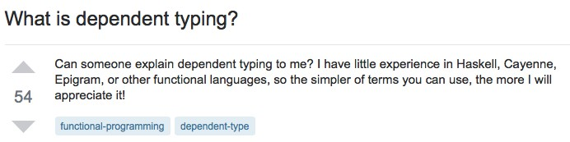
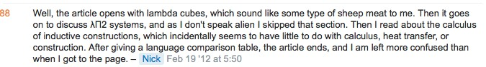
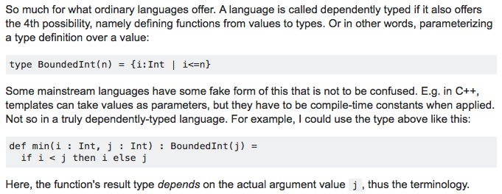
A word of caution…
Recap
This area of study has addictive potential…
But, the material available (in print as well as online) is not very beginner friendly. For instance…
Maybe you have a better idea now about what the Wikipedia article that Nick complained about is talking about!
A curious Nick asks on stackoverflow:
Karl wonders why this is a problem:
Nick wonders if he is on another planet:
https://stackoverflow.com/questions/9338709/what-is-dependent-typing
Eventually, an understandable answer was posted, but it may have been too late for Nick…:
Personal experience: The material looks difficult at first, but is actually quite easy (and fun) once you start applying it!
(As opposed to other areas of software engineering such as domain modelling, where the opposite is true)

Slide 13
But what about Subtyping, Covariance, & Contravariance?
Excerpts from ”Types and programming languages" (working draft Jan 15 2000 & 2002 edition) by Benjamin C. Pierce

Slide 14
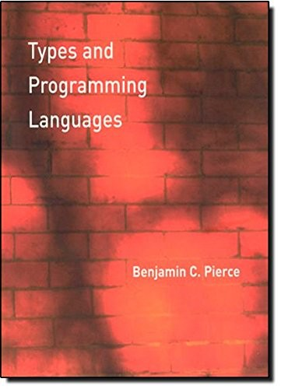
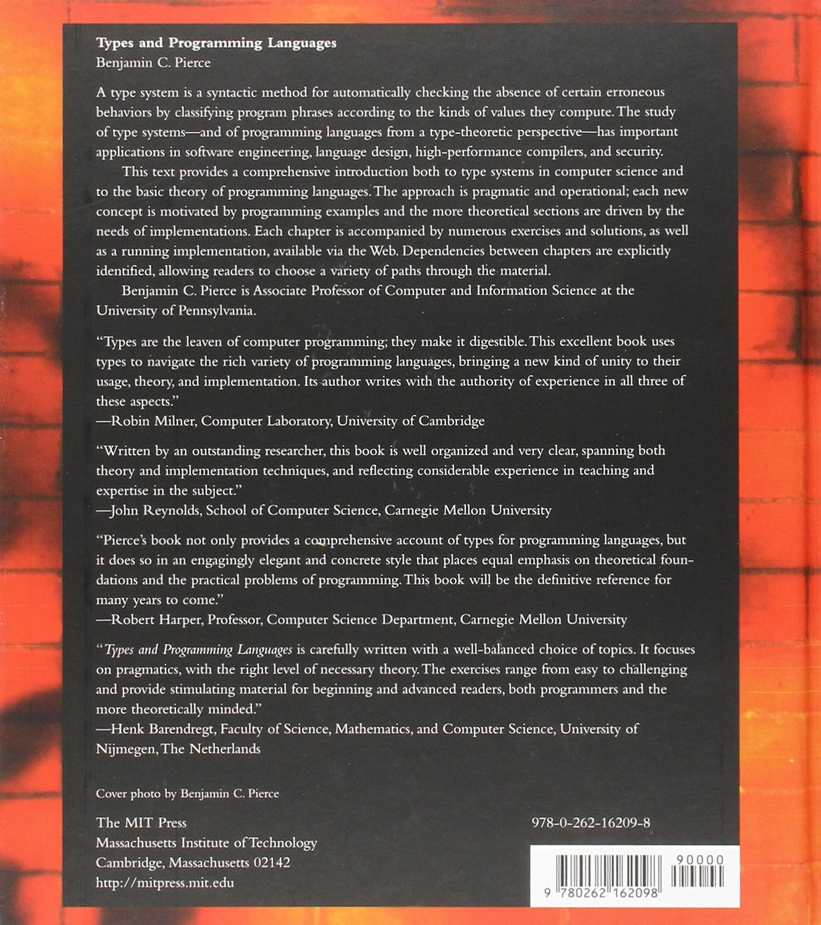
Further Reading
Types and Programming Languages
by Benjamin C. Pierce

Slide 15
Goals
Each participant should be able to:
Explain how type checking and type inference is done in the simply typed lambda calculus and the polymorphic lambda calculus.
Perform type checking and simple type inference in these type systems.
Read, understand and explain standard texts in this area.
Explain the concepts subtyping, covariance & contravariance.

Slide 16
But what about Subtyping? (Excerpts from 2002 edition)

